Slide 1
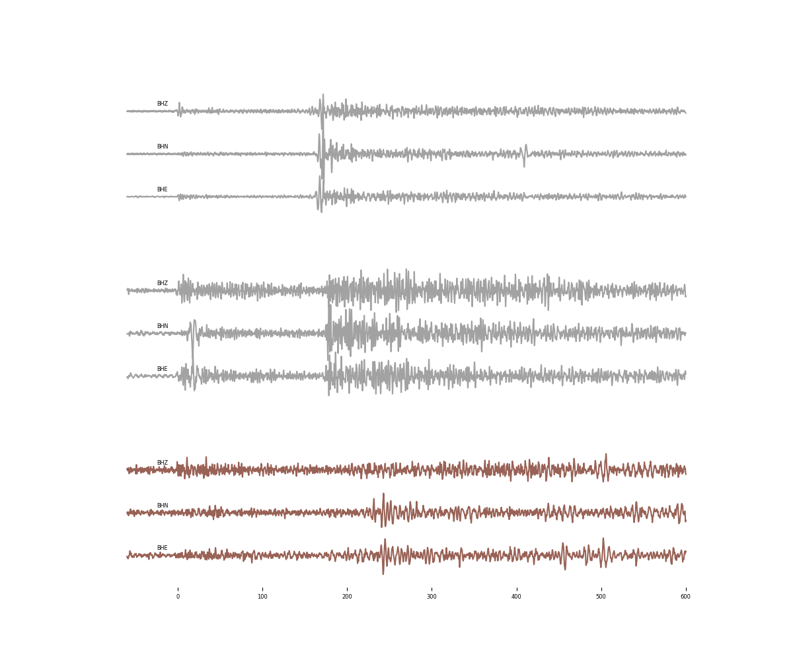
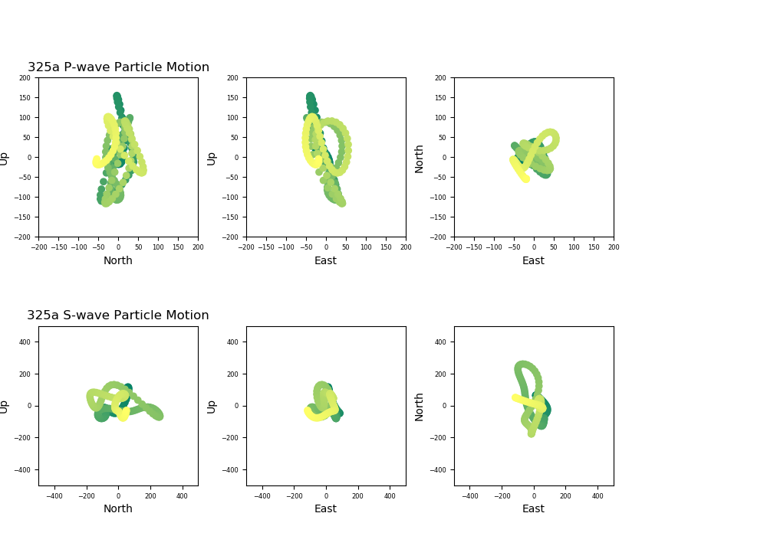
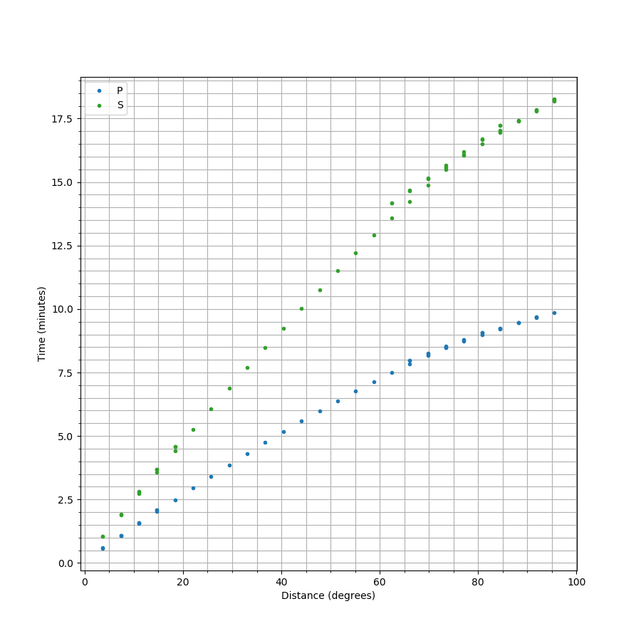


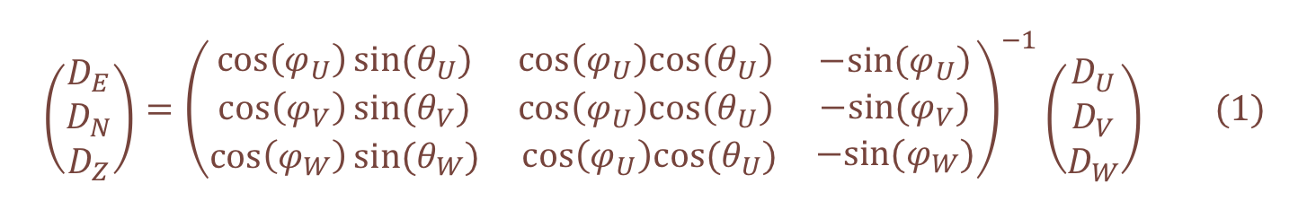
Using Data from
InSight to Explain and Locate Marsquakes
Everything we thought we knew about Marsquakes
Fig 1. This figure comes from NASA’s Bruce Murray Space Image Library
Mars’ crust is composed of a single tectonic plate and therefore intraplate tectonics, such as faulting, and impacts are expected to be the major contributors to the seismicity of the planet^{1,2}.
The lander is located about 1600km west of the Cerberus Fossae region, which is hypothesized to be an active tectonic structure and a major contributor to Mars’ seismicity^{3,4}.
Maddy Sita¹ & Suzan van der Lee²
¹ University of Virginia, ² Northwestern University
S0235b
UTC2019-07-26T12:19:19
Collecting and analyzing data from IRIS Webservices
The instrument of interest for this project is the very broadband (VBB) seismometer, which is a part of the seismometer package, Seismic Experiment for Internal Structure (SEIS). The waveform data was downloaded directly from the Incorporated Research Institutions for Seismology (IRIS) database web service exploited by a function of the python package ObsPy. Using the equation below, we orientated the data such that each data stream now pointed in the north, east and vertical direction.
S0173a
UTC2019-05-23T02:22:59
$$\left({D_{E} \atop \begin{aligned}D_{N} \\ D_{Z}\end{aligned}}\right)={\left(\begin{matrix}\cos\left(φ_{U}\right)sin⁡(θ_{U}) & \cos\left(φ_{U}\right)cos\left(θ_{U}\right) \\ \begin{aligned}\cos\left(φ_{V}\right)sin⁡(θ_{V}) \\ \cos\left(φ_{W}\right)sin⁡(θ_{W})\end{aligned} & \begin{aligned}\cos\left(φ_{U}\right)cos\left(θ_{U}\right) \\ cos⁡\left(φ_{U}\right)cos(θ_{U})\end{aligned} \end{matrix}\begin{matrix}−sin⁡(φ_{U}) \\ −sin⁡(φ_{V}) \\ −sin⁡(φ_{W})\end{matrix}\right)}^{−1}\left({D_{U} \atop \begin{aligned}D_{V} \\ D_{W}\end{aligned}}\right) (1)$$
S0325a
Locating Marsquakes with a single detector
After analyzing the candidates in different frequency spaces, we identified one event as likely having seismic origin in addition to our two previously stated references. The event, now known as S0325a, occurred on 26 October 19 with the P-wave arriving at 06:58:58 UTC and the S-wave arriving at 07:02:56 UTC.
UTC2019-10-26T06:58:58
Fig 2. This figure was adopted from Giardini et al. 2020 to include the new event.⁵
Particle Motion
Based on orbital imagery Cerberus Fossae is predicted to be an active graben system⁴. It is hypothesized that majority of the faults in this system will be reverse faults due to the global contraction of the planet^{1.}
This particle motion seems to show a movement of the direction of the event over time from the south-east to the north-east. It is possible that not all of the energy in this time window is P-wave energy.
Strike-slip
S0325a
The three possible types of source mechanism is a normal, reverse of strike-slip fault.
Each can be characterized by a unique set of strike, dip and rake angles.
Possible Ray Paths
of Seismic Waves
Normal
Reverse
Event Name: | Distance: | Back Azimuth: | Source Mechanism
S0173a | 29° | 91° | Likely shear factor
S0235b | 27.5° | 74° | Likely shear factor
S0325a | 38.5° | 123° | Likely shear factor
Time Travel Plot for Gudkova Model
LVL?
P
What does this tell us about Mars and the future of planetary sciences?
S
3:58
Based on the estimated location of S0325a, it can be concluded that the event most likely did not originate from Cerberus Fossae. However, there is evidence of faulting in this new area as seen by orbital imagery⁵. The particle motion suggests a moving source mechanism but dust devils would not be strong enough to produce low-frequency events.
By also gaining a better understanding of seismology using a single instrument, we can begin to develop better technology and data processing techniques. These updated methods can then be used to investigate the interior of other small bodies in our solar system, like Europa or Titan.
Core
Mantle
Crust
This material is based upon work supported by the National Science Foundation under Grant No. AST-1757792, a Research Experiences for Undergraduates (REU) grant awarded to CIERA at Northwestern University. Any opinions, findings, and conclusions or recommendations expressed in this material are those of the author(s) and do not necessarily reflect the views of the National Science Foundation.
1. Clinton, J., Giardini, D., Böse, M. et al. The Marsquake Service: Securing Daily Analysis of SEIS Data and Building the Martian Seismicity Catalogue for InSight. Space Sci Rev 214, 133 (2018). https://doi.org/10.1007/s11214-018-0567-5
2. Lognonné, P., Banerdt, W.B., Giardini, D. et al. SEIS: Insight’s Seismic Experiment for Internal Structure of Mars. Space Sci Rev 215, 12 (2019). https://doi.org/10.1007/s11214-018-0574-6
3. Banerdt, W.B., Smrekar, S.E., Banfield, D. et al. Initial results from the InSight mission on Mars. Nat. Geosci. 13, 183–189 (2020). https://doi.org/10.1038/s41561-020-0544-y
4. Taylor, J., Teanby, N. A., and Wookey, J. (2013), Estimates of seismic activity in the Cerberus Fossae region of Mars, J. Geophys. Res. Planets, 118, 2570– 2581, doi:10.1002/2013JE004469.
5. Giardini, D., Lognonné, P., Banerdt, W.B. et al. The seismicity of Mars. Nat. Geosci. 13, 205–212 (2020). https://doi-org.proxy01.its.virginia.edu/10.1038/s41561-020-0539-8

Slide 2


INSPO
Notes:
Images on poster draft:
Interior diagrams - https://www.planetary.org/space-images/interior-structures-of-earth-mars-moon
Vbb diagrams - https://link.springer.com/article/10.1007/s11214-018-0574-6
https://agupubs.onlinelibrary.wiley.com/action/downloadSupplement?doi=10.1029%2F2020GL087123&file=grl60770-sup-0001-sup_revised.pdf
Graben system diagram - https://en.wikipedia.org/wiki/Horst_and_graben
New reverse fault diagram - https://www.thoughtco.com/fault-types-with-diagrams-3879102

